Slide 1
Hotel Reservations Cancellation Prediction
Akshaya Mamidipalli

Slide 2
Dataset overview
This project aims to dissect and understand the factors leading to hotel booking cancellations using advanced data analytics and machine learning techniques. By analyzing a dataset of over 36,000 hotel bookings, our goal is to identify patterns and predictors of cancellations, thereby enabling hotel managers to formulate strategies that mitigate cancellation rates and enhance customer satisfaction, ultimately driving revenue optimization.
The dataset contains 36,275 hotel booking records, each with 19 characteristics relating to different parts of the reservation process. These factors include client demographics, booking behavior, room preferences, special requests, and the final booking status, among other information.

Slide 3
Exploratory Data Analysis (EDA)
The initial phase of our analysis involved exploratory data analysis (EDA) to uncover underlying patterns and trends within the data. Techniques included statistical summaries, correlation analysis, and a variety of visualizations such as bar charts, histograms, and scatter plots. These explorations provided a preliminary understanding of key factors such as the impact of lead time on cancellations and seasonal booking fluctuations.

Slide 4
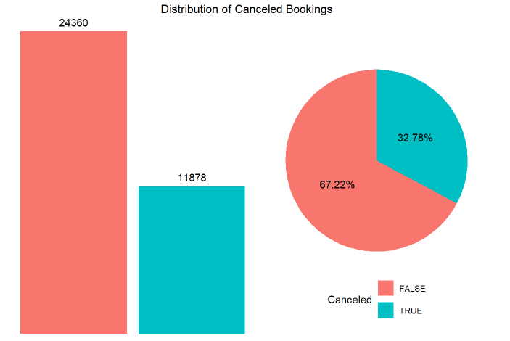
Cancellation Rate Insights
Our analysis highlighted that approximately 32.78% of all bookings were canceled. A deeper dive into the data via pie charts and bar graphs indicated that longer lead times and certain times of the year, particularly holiday seasons, were associated with higher cancellation rates. These insights are crucial for developing targeted strategies to reduce cancellations.

Slide 5
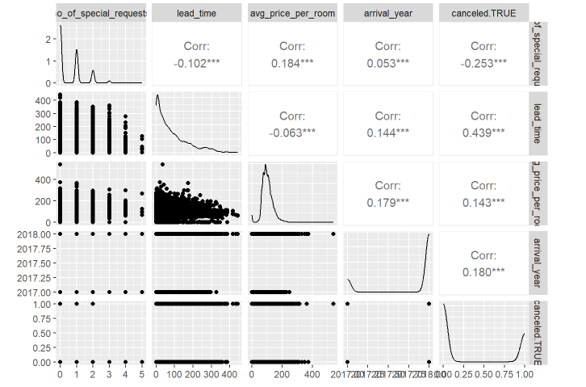
Graphical representations
Bar charts for cancellation distribution, line graphs for pricing trends, and density plots for booking variations, provide valuable information for strategic decisions. These visualizations assist in immediately spotting trends, outliers, and patterns that textual data may not disclose.

Slide 6
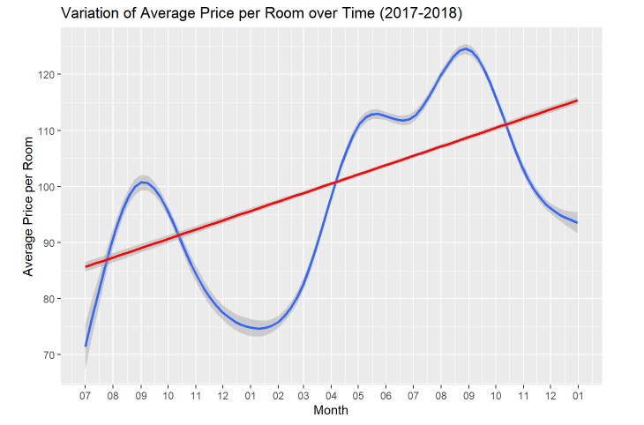
Price Sensitivity and Demand
The study of price sensitivity showed that booking rates and cancellations are influenced by pricing strategies. During periods of high demand, higher prices did not deter bookings, whereas lower prices during off-peak periods helped in reducing cancellations. These findings suggest the potential for dynamic pricing models to optimize revenue.

Slide 7
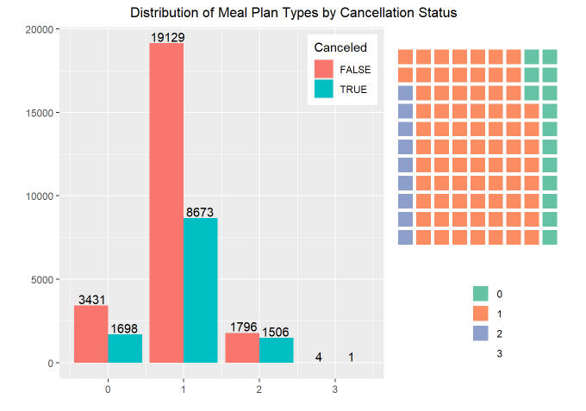
Predictive Modeling Approach
To predict cancellations, we employed several machine learning models including decision trees, logistic regression, and random forests. Each model was trained to identify the likelihood of a booking being canceled based on features extracted from the data, such as lead time, number of special requests, and type of meal plan chosen.

Slide 8
Methodologies and Modeling Strategy
Feature Selection for Hotel Reservations Data Analysis & Classification Feature selection is a critical phase in the data analytics process, particularly in predictive modeling tasks like classification. It entails picking the most relevant features to include in models based on their relevance to the response variable. For Hotel Reservations data, smart feature selection would not only increase model performance but also minimize complexity and improve interpretability.

Slide 9


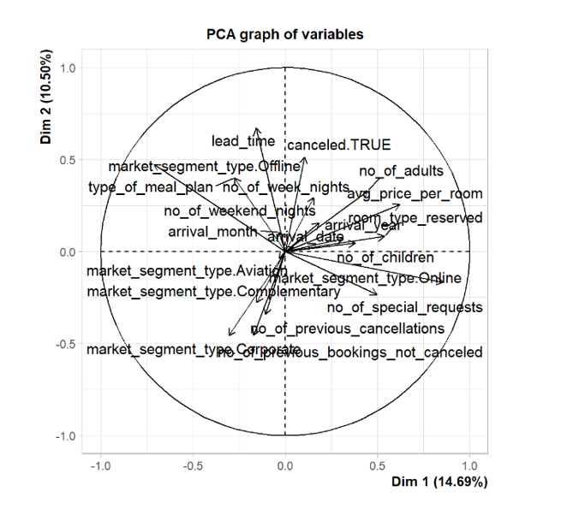

Primary PCA
Primary PCA includes converted market segment type variable and the target variable “canceled” to numerical variable using dummyVars which created additional 6 features to the dataset.
This PCA helps for the feature selection to better build the desired model.

Slide 10
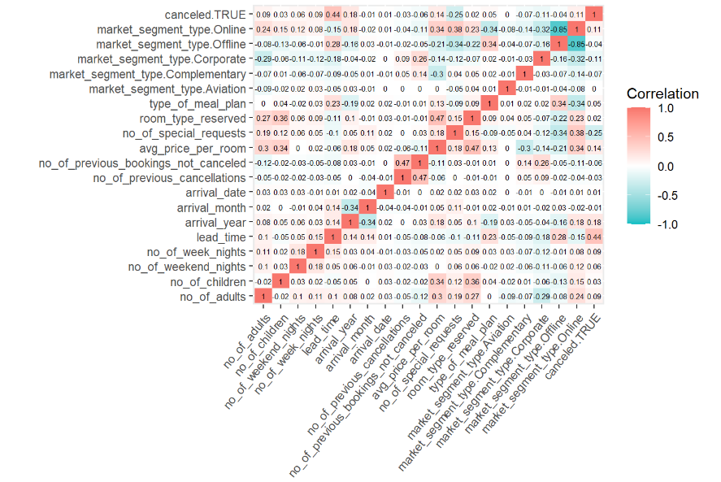
Correlation Analysis
z
Key aspects such as lead time, special requests, average price per room and arrival year have various degrees of connection with cancellation, indicating that these variables should be included in predictive models.

Slide 11
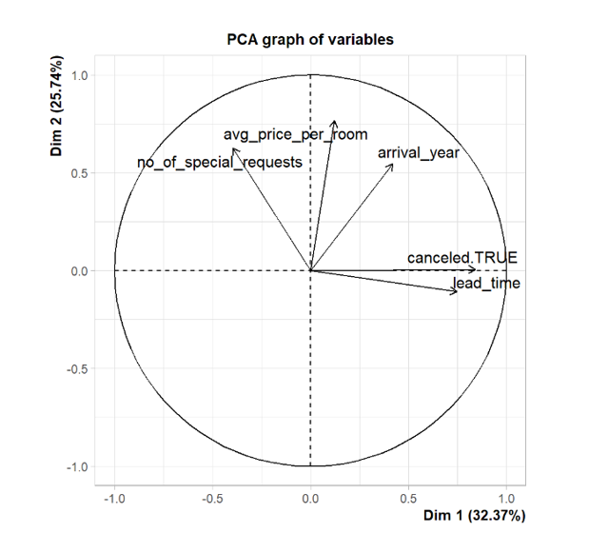
PCA after the feature selection
The features selected are lead time, special requests, average price per room and arrival year to predict my target variable canceled. TRUE

Slide 12
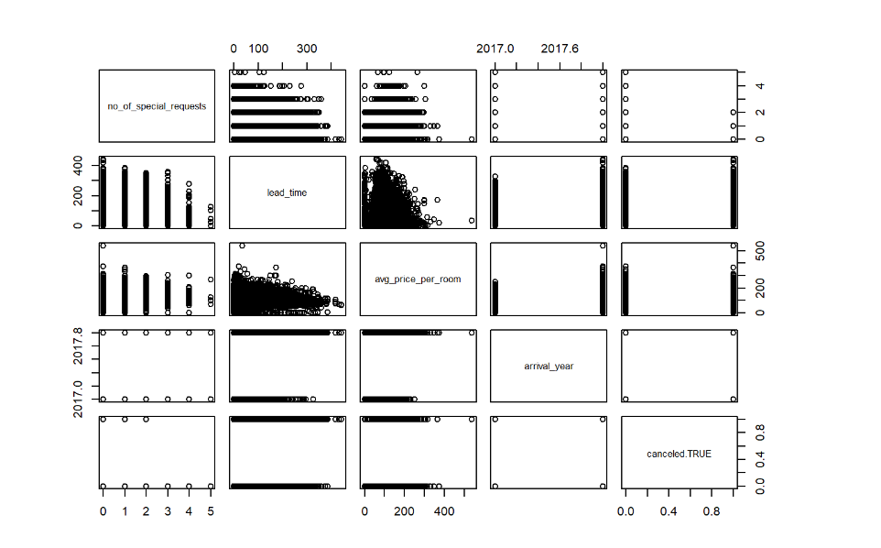
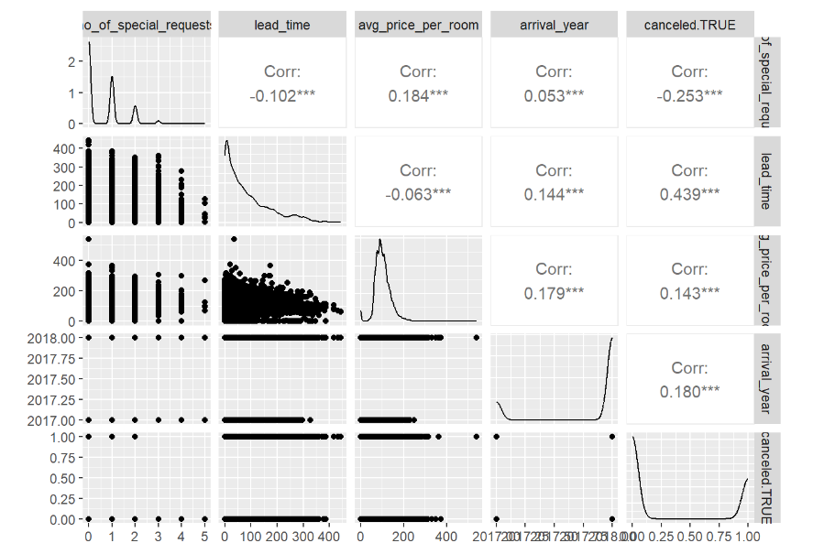
Graphical Representation of selected variables

Slide 13
Models Performance Results
In this study, two machine learning models, K-Nearest Neighbors (KNN) and Naive Bayes, were used to predict cancellation events from a hotel booking dataset. The models were examined using numerous measures to determine their accuracy in forecasting whether a hotel reservation would be canceled.
Metric | K-Nearest Neighbors (KNN) | Naive Bayes
Accuracy | 80.56% | 77.15%
Precision | 76.35% | 70.05%
Recall | 58.36% | 52.12%
F1 Score | 66.15% | 59.77%

Slide 14
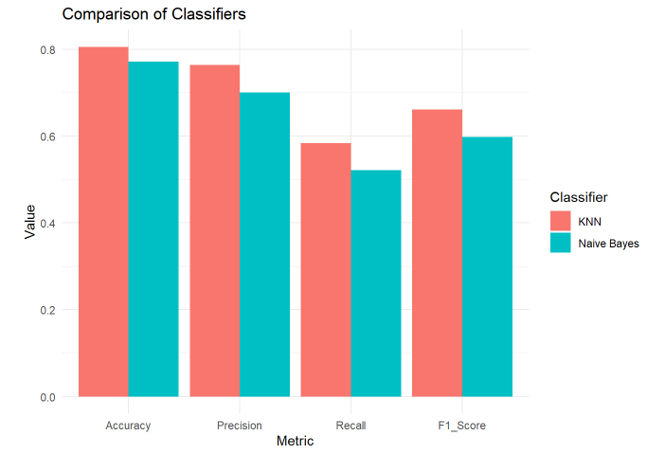
Comparison Of Models
The KNN model outperformed the Naive Bayes model on most criteria. It earned improved accuracy, precision, recall, and F1 score, showing better overall performance in distinguishing between canceled and non-canceled bookings as well as dealing with the data's unbalanced nature.
This could be owing to KNN's capacity to construct a boundary based on the actual distribution of data in multidimensional space, which is more flexible than Naive Bayes' very strict feature independence assumptions.

Slide 15
THANK YOU

